Slide 1
Data Structures
Trees

Slide 2
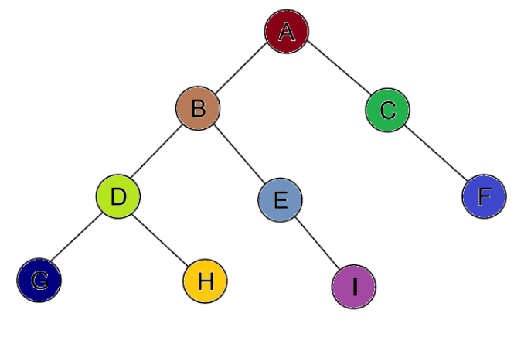
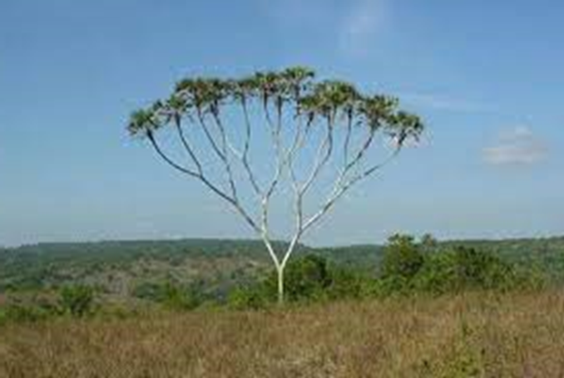
Tree data structure
Real tree

Slide 3
Tree is a non-primitive, nonlinear data structure, which organizes data in a hierarchical design.
Trees are used in many applications to represent the relationship among the data elements that are nodes.
In the tree data structure, every singular element is called a node.
Tree data structure does not contain any cycle.
In a tree data structure, if we have N number of nodes, then we have a maximum of N-1 number of links or edges.

Slide 4
Binary Tree is a special data structure used for data storage purposes.
A binary tree has a special condition that each node can have a maximum of two children.
Each node in a binary tree stores the actual data of that particular element and the link part store address of the left or right subtree in a hierarchical manner.
A binary tree has the benefits of both an ordered array and a linked list as search is as quick as in a sorted array and insertion or deletion operation are as fast as in linked list.

Slide 5
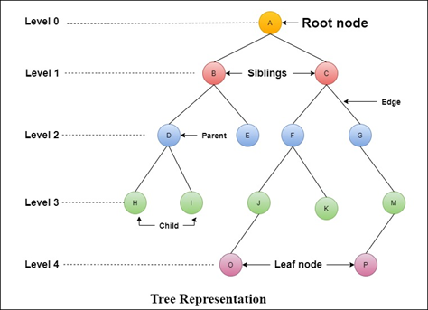
Sub-tree

Slide 6
Root node:
The first node in the tree is called a root node.
A parent-free node is referred to as a root node.
Every tree has one root node.
Edge:
The connecting link between any two nodes is called an edge. A tree with several nodes ‘N’ will have a maximum number N-1 of edges.
Parent:
The node which is the ancestor of any node is called the parent node. In simple terms, the node which has branched from it to any other node is known as the parent node. A parent node can also be described as, “the node that has a child or children”.

Slide 7
Child:
The node that is a descendant of any node is referred to as a child node. In simple terms, the node that has an edge on its parent node is called the child node. Within a tree data structure, any parent node may have any number of child nodes. In a tree, all the nodes except the root are child nodes.
Siblings:
The nodes belonging to the same parent are referred to as brothers and sisters or siblings. In simple words, the nodes with the same parent are called sibling nodes.

Slide 8
Leaf:
The node with no child is called a leaf node. In simple terms, a leaf node is a node that has no child.
In a tree data structure, leaf nodes are also known as external nodes. External node is also a node with no child.
Internal nodes:
The node that has at least one child is referred to as the internal node. In simple terms, an internal node is a node with at least one child.
In a tree data structure, nodes other than leaf nodes or external nodes are called internal nodes. The root node is also considered an internal node if the tree structure has more than one node. Internal nodes are also called non-terminal nodes.

Slide 9
Degree:
The total number of children of a node is known as the degree of that node. Simply stated, the degree of a node in a tree data structure is the total number of child nodes it has.
The highest degree of a node among all the nodes of a tree is termed as ‘degree of tree’.
Level:
The root node is stated to be at Level 0 and the children of the root node are at Level 1 and the children of the nodes which are at Level 1 will be at Level 2 and so on. Simply stated, in a tree data structure, each step from top to bottom is called a Level, and the Level count starts with ‘0’ and is incremented by one at each level or step.

Slide 10
Depth:
The total number of edges from the root node to a particular node is called the depth of that node.
In a tree, the total number of edges from the root node to a leaf node in the longest path is said to be the depth of the tree.
Path:
The sequence of nodes and edges from one node to another node is called a path between the two nodes. The length of a path represents the total number of nodes on that path.
Sub-tree:
Each child of a node forms a subtree recursively.
Each child node consists of a sub-tree with its parent node.

Slide 11
Binary Trees
It is one of the most widely used non-linear data structures in the field of computer science. It is a restricted form of a general tree. The restriction that it applies to a general tree is that its nodes can have a maximum degree of 2. That means, the nodes of a binary tree can have zero, one or two child nodes but not more than that.
A binary tree with only one node is a binary tree with a root in which the left and right sub-trees are empty. If there are two nodes in a binary tree, one will be the root and another can be either the left or the right child of the root.

Slide 13
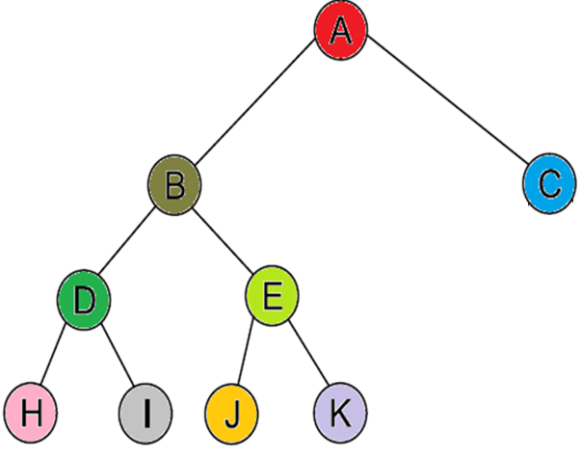
Strictly binary tree
A Binary Tree is called a Strictly Binary Tree if each parent node contains either no or two children.

Slide 14
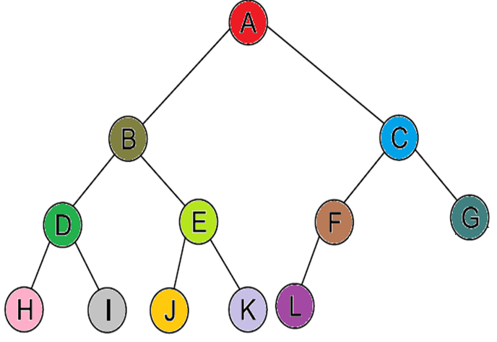
Complete binary tree
A binary tree of depth d is called complete binary tree if all the levels of the tree are filled completely except the lowest level nodes which are filled from as left as possible.

Slide 15
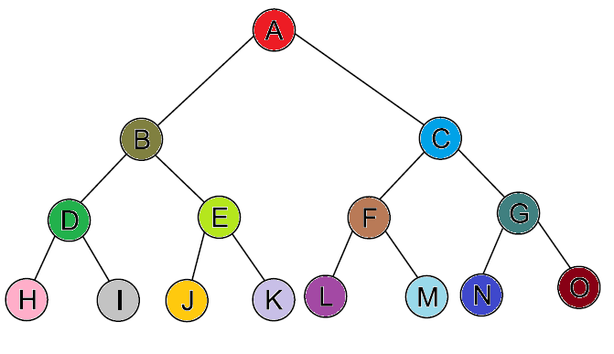
Perfect binary tree
A binary tree is called perfect binary tree if all its leaf nodes are at the lowest level and all the non-leaf nodes contain two child nodes.

Slide 16
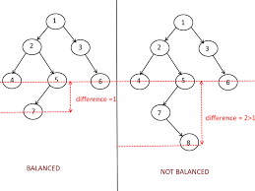
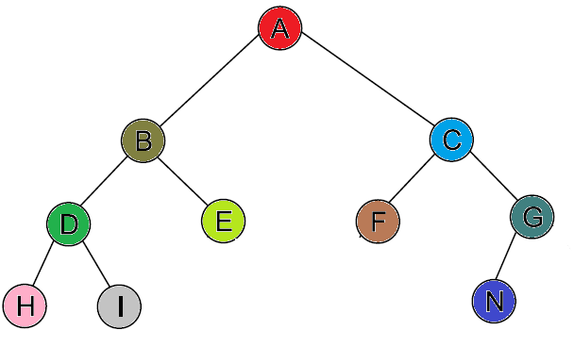
Balanced binary tree
A binary tree is called balanced binary tree if the depths of the subtrees of all its nodes do not differ by more than 1.

Slide 17
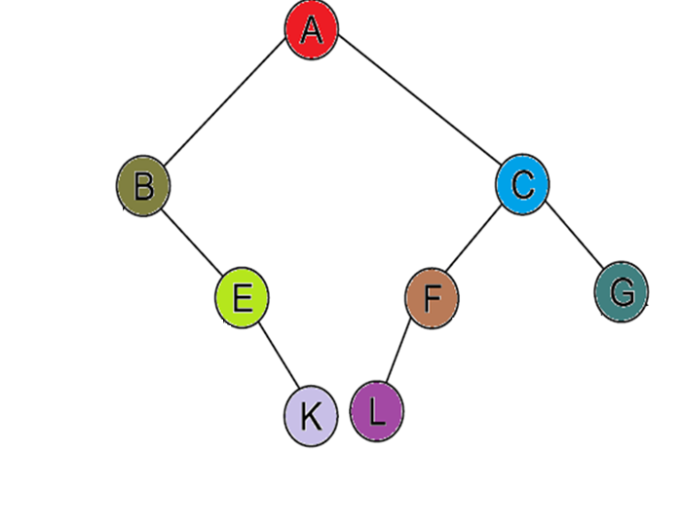
Adelson-Velsky and Landis Trees (AVL Trees)
also called height-balanced tree

Slide 18
Binary search tree (BST)
If a binary tree has the property that all elements in the left subtree of a node n are lesser than or equal to the contents of n and all elements in the right sub-tree are greater than the contents of n, such a binary tree is called a binary search tree (BST).
In a BST, if the same elements are inserted, then the same element is inserted on the left side of the node, having the same value.

Slide 19
Binary Tree Representation
There are two binary tree representation techniques:
Sequential representation or array representation.
Linked representation or linked list representation.

Slide 20
Array Representation
In this representation, one-dimensional array is used for storing the node elements using the following rules:
The root node is stored in the first position in the array while its left and right child nodes are stored at the successive positions.
2. If a node is stored at index location i then its left child node will be stored at location 2i+1 while the right child node will be stored at location 2i+2.

Slide 21
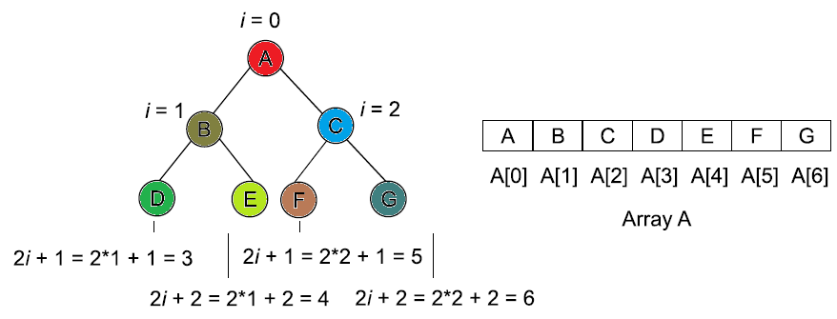

Slide 22
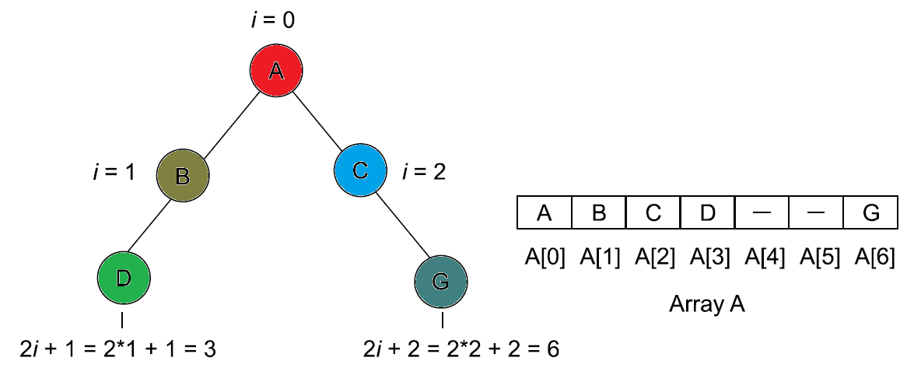

Slide 23
Linked Representation
To avoid the disadvantages associated with array representation, linked representation is used for implementing binary trees. It uses a linked list for storing the node elements. Each tree node is represented
with the help of the linked list node comprising of the following fields:
1. INFO Stores the value of the tree node.
2. LEFT Stores a pointer to the left child.
3. RIGHT Stores a pointer to the right child.

Slide 24
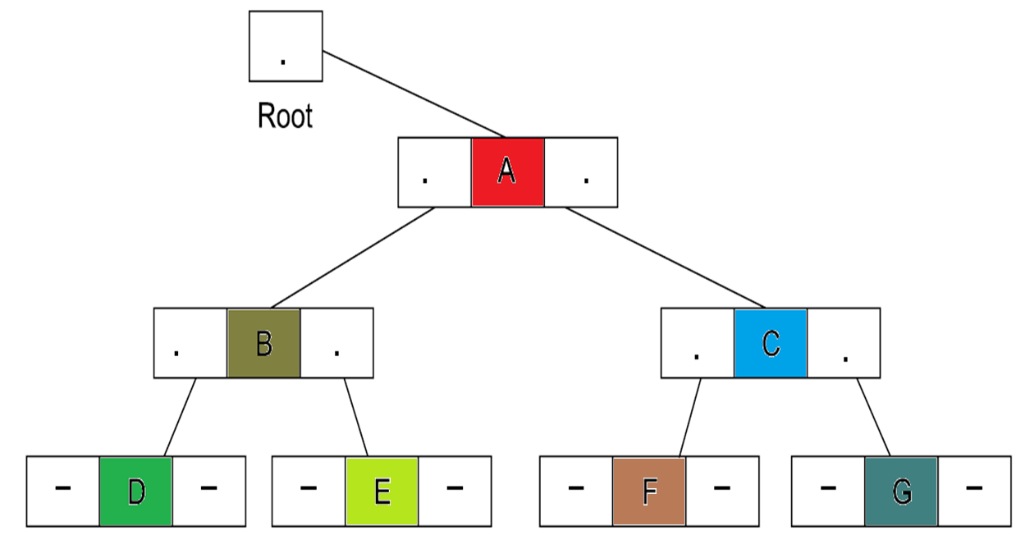

Slide 25
struct node
{
int INFO;
struct node *LEFT, *RIGHT;
};

Slide 26
Operations on Binary Tree
Create a binary tree.
Traverse a binary tree.
Insert any node in the binary tree as the left child or right child of any node.
Delete a node from a binary tree.

Slide 27

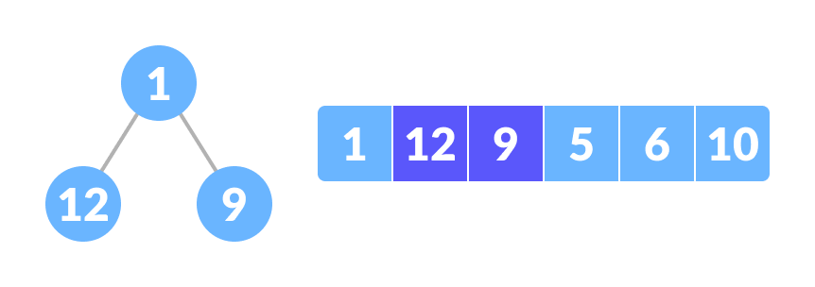
Create a binary tree
Select the first element of the list to be the root node
Put the second element as a left child of the root node and the third element as the right child.

Slide 28
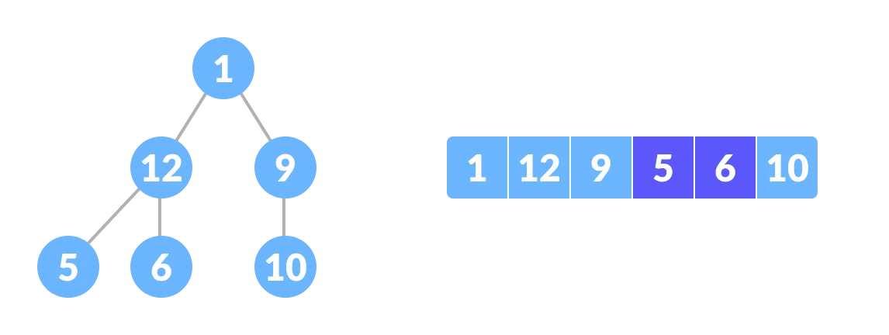
Put the next two elements as children of the left node of the second level. Again, put the next two elements as children of the right node of the second level (elements).
Keep repeating until you reach the last element

Slide 29
Binary Tree Traversals
Traversing the tree means visiting each node in the tree exactly once.
L means move to left child.
R means move to right child.
R’ means move to root or parent node.
Therefore, there are six different combinations of L, R, R’ nodes as LR’R, LRR’, R’LR, R’RL, RR’L and RLR’.
The three traversing methods are important, which are as follows:
Left-Root-Right (LR’R): In-order traversal.
Root-Left-Right (R’LR): Preorder traversal.
Left-Right-Root (R’LR): Post-order traversal.

Slide 30
Preorder traversal
This technique follows the 'root left right' policy. It means that, first root node is visited after that the left subtree is traversed recursively, and finally, right subtree is recursively traversed.
As the root node is traversed before (or pre) the left and right subtree, it is called preorder traversal.
In a preorder traversal, each node is visited before both of its subtrees.
Step 1 - Visit the root node
Step 2 - Traverse the left subtree recursively.
Step 3 - Traverse the right subtree recursively.

Slide 31
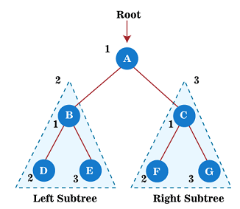
A → B → D → E → C → F → G

Slide 32
Postorder traversal
This technique follows the 'left-right root' policy. It means that the first left subtree of the root node is traversed, after that recursively traverses the right subtree, and finally, the root node is traversed.
As the root node is traversed after (or post) the left and right subtree, it is called postorder traversal.
In a postorder traversal, each node is visited after both of its subtrees.
Step 1 - Traverse the left subtree recursively.
Step 2 - Traverse the right subtree recursively.
Step 3 - Visit the root node.

Slide 33
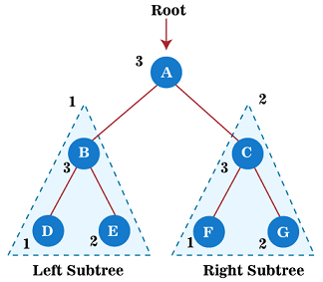
D → E → B → F → G → C → A

Slide 34
Inorder traversal
This technique follows the 'left root right' policy. It means that first left subtree is visited after that root node is traversed, and finally, the right subtree is traversed.
As the root node is traversed between the left and right subtree, it is named inorder traversal.
In the inorder traversal, each node is visited in between of its subtrees.
Step 1 - Traverse the left subtree recursively.
Step 2 - Visit the root node.
Step 3 - Traverse the right subtree recursively.

Slide 35
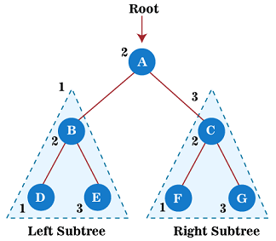
D → B → E → A → F → C → G

Slide 36

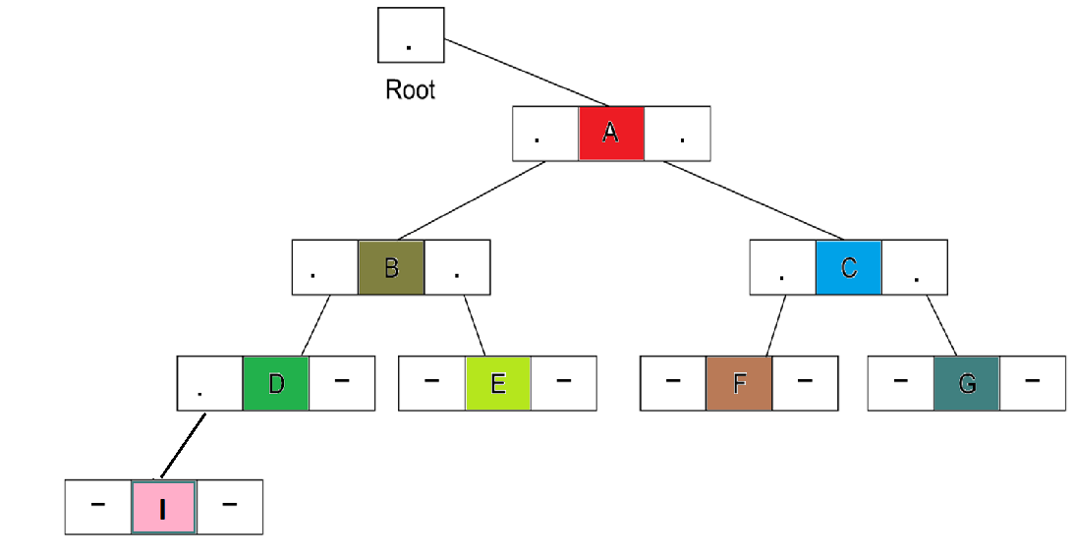
Insertion in general binary tree
In general binary tree we can insert a node in left or right direction of the current node starting from the root of the tree (How?).
Insertion a node in the left

Slide 37
Deletion in general binary tree
To delete a node in general binary tree we first find the location of that node in the tree and depending on that location we rearrange the tree after the deletion.
Delete a leaf node.
Delete a parent node with one child.
Delete a parent node with two child.
Delete the root node.
We will discuss that in BST lecture.

